Slide 1
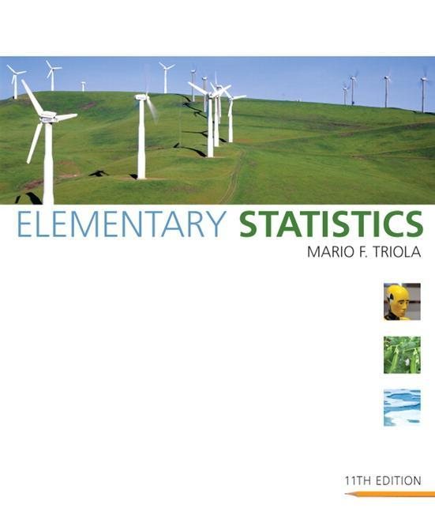
Lecture Slides
Elementary Statistics Eleventh Edition
and the Triola Statistics Series
by Mario F. Triola

Slide 2
Chapter 9 Inferences from Two Samples
9-1 Review and Preview
9-2 Inferences About Two Proportions
9-3 Inferences About Two Means: Independent Samples
9-4 Inferences from Dependent Samples
9-5 Comparing Variation in Two Samples

Slide 3
Section 9-1
Review and Preview

Slide 4
Review
In Chapters 7 and 8 we introduced methods of inferential statistics. In Chapter 7 we presented methods of constructing confidence interval estimates of population parameters. In Chapter 8 we presented methods of testing claims made about population parameters. Chapters 7 and 8 both involved methods for dealing with a sample from a single population.
Notes:
page 456 of Elementary Statistics, 10th Edition
Examples in the discussion

Slide 5
Preview
The objective of this chapter is to extend the methods for estimating values of population parameters and the methods for testing hypotheses to situations involving two sets of sample data instead of just one. The following are examples typical of those found in this chapter, which presents methods for using sample data from two populations so that inferences can be made about those populations.
Notes:
page 456 of Elementary Statistics, 10th Edition
Examples in the discussion

Slide 6
Preview
Test the claim that when college students are weighed at the beginning and end of their freshman year, the differences show a mean weight gain of 15 pounds (as in the “Freshman 15” belief).
Test the claim that the proportion of children who contract polio is less for children given the Salk vaccine than for children given a placebo.
Test the claim that subjects treated with Lipitor have a mean cholesterol level that is lower than the mean cholesterol level for subjects given a placebo.
Notes:
Examples in the discussion

Slide 7
Section 9-2
Inferences About Two Proportions
Copyright © 2010 Pearson Education

Slide 8
Key Concept
In this section we present methods for (1) testing a claim made about the two population proportions and (2) constructing a confidence interval estimate of the difference between the two population proportions. This section is based on proportions, but we can use the same methods for dealing with probabilities or the decimal equivalents of percentages.
Copyright © 2010 Pearson Education

Slide 9
Notation for Two Proportions
For population 1, we let:
p₁ = population proportion
n₁ = size of the sample
x₁ = number of successes in the sample
^
x₁
p₁ = (the sample proportion)
q₁ = 1 – p₁
n₁
^
^
The corresponding notations apply to
^
^
p₂, n₂ , x₂ , p₂. and q₂ , which come from population 2.
Copyright © 2010 Pearson Education

Slide 10
Pooled Sample Proportion
The pooled sample proportion is denoted by p and is given by:
x₁ + x₂
p
=
n₁ + n₂
We denote the complement of p by q, so q = 1 – p
Copyright © 2010 Pearson Education

Slide 11
Requirements
1. We have proportions from two independent simple random samples.
2. For each of the two samples, the number of successes is at least 5 and the number of failures is at least 5.
Copyright © 2010 Pearson Education
Notes:
page 457 of Elementary Statistics, 10th Edition

Slide 12
Test Statistic for Two Proportions
For H₀: p₁ = p₂
H₁: p₁ ≠ p₂ , H₁: p₁ < p₂ , H₁: p ₁> p₂
^
^
( p₁ – p₂ ) –
( p₁ – p₂ )
z =
pq
pq
+
n₂
n₁
Copyright © 2010 Pearson Education
Notes:
Example given at the bottom of page 458-460 of Elementary Statistics, 10th Edition.

Slide 13
Test Statistic for Two Proportions - cont
For H₀: p₁ = p₂
H₁: p₁ ≠ p₂ , H₁: p₁ < p₂ , H₁: p ₁> p₂
where p₁ – p ₂ = 0 (assumed in the null hypothesis)
^
x₁
^
x₂
p₁
and
p₂
=
n₁
=
n₂
x₁ + x₂
p =
q = 1 – p
and
n₁ + n₂
Copyright © 2010 Pearson Education

Slide 14
Test Statistic for Two Proportions - cont
P-value: Use Table A-2. (Use the computed value of the test statistic z and find its P-value by following the procedure summarized by Figure 8-5 in the text.)
Critical values: Use Table A-2. (Based on the significance level α, find critical values by using the procedures introduced in Section 8-2 in the text.)
Copyright © 2010 Pearson Education

Slide 15
Confidence Interval Estimate of p₁ – p₂
^
^
^
^
( p₁ – p₂ ) – E < ( p₁ – p₂ ) < ( p₁ – p₂ ) + E
^
^
^
^
where E = z_{α/2}
p₁ q₁
p₂ q₂
+
n₁
n₂
Copyright © 2010 Pearson Education
Notes:
Example at the bottom of page 461 of Elementary Statistics, 10th Edition
Rationale for the procedures of this section on page 462-463 of Elementary Statistics, 10th Edition

Slide 16
Example:
The table below lists results from a simple random sample of front-seat occupants involved in car crashes. Use a 0.05 significance level to test the claim that the fatality rate of occupants is lower for those in cars equipped with airbags.
Copyright © 2010 Pearson Education

Slide 17
Example:
Requirements are satisfied: two simple random samples, two samples are independent; Each has at least 5 successes and 5 failures (11,500, 41; 9801, 52).
Use the P-value method.
Step 1: Express the claim as p₁ < p₂.
Step 2: If p₁ < p₂ is false, then p₁ ≥ p₂.
Step 3: p₁ < p₂ does not contain equality so it is the alternative hypothesis. The null hypothesis is the statement of equality.
Copyright © 2010 Pearson Education

Slide 18
Example:
H₀: p₁ = p₂ H_{a}: p₁ < p₂ (original claim)
Step 4: Significance level is 0.05
Step 5: Use normal distribution as an approximation to the binomial distribution. Estimate the common values of p₁ and p₂ as follows:
With
it follows
Copyright © 2010 Pearson Education

Slide 19
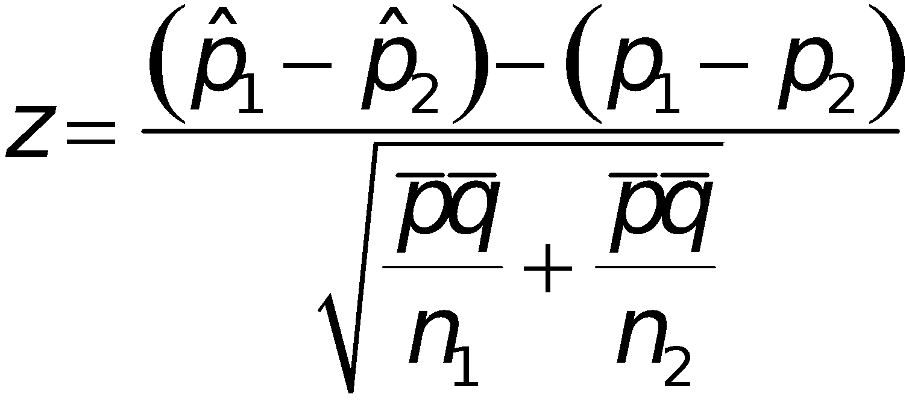
Example:
Step 6: Find the value of the test statistic.
Copyright © 2010 Pearson Education

Slide 20
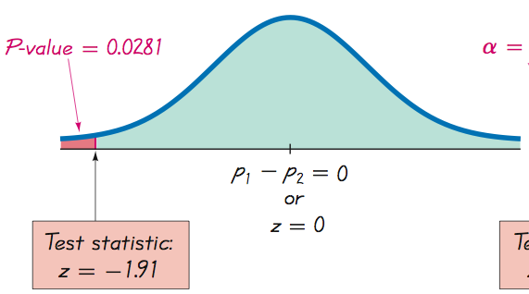
Example:
Left-tailed test. Area to left of z = –1.91 is 0.0281 (Table A-2), so the P-value is 0.0281.
Copyright © 2010 Pearson Education

Slide 21
Example:
Step 7: Because the P-value of 0.0281 is less than the significance level of α = 0.05, we reject the null hypothesis of p₁ = p₂.
Because we reject the null hypothesis, we conclude that there is sufficient evidence to support the claim that the proportion of accident fatalities for occupants in cars with airbags is less than the proportion of fatalities for occupants in cars without airbags. Based on these results, it appears that airbags are effective in saving lives.
Copyright © 2010 Pearson Education

Slide 22
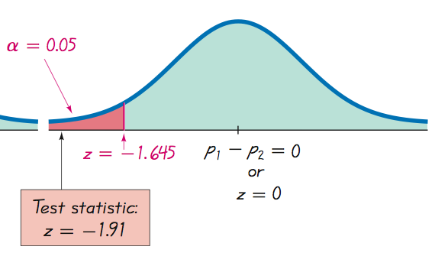
Example: Using the Traditional Method
With a significance level of α = 0.05 in a left- tailed test based on the normal
distribution, we refer to Table A-2 and find that an area of α = 0.05 in the left tail corresponds to the critical value of z = –1.645. The test statistic of does fall in the critical region bounded by the critical value of z = –1.645. We again reject the null hypothesis.
Copyright © 2010 Pearson Education

Slide 23
Caution
When testing a claim about two population proportions, the P-value method and the traditional method are equivalent, but they are not equivalent to the confidence interval method. If you want to test a claim about two population proportions, use the P-value method or traditional method; if you want to estimate the difference between two population proportions, use a confidence interval.
Copyright © 2010 Pearson Education

Slide 24
Example:
Use the sample data given in the preceding Example to construct a 90% confidence interval estimate of the difference between the two population proportions. (As shown in Table 8-2 on page 406, the confidence level of 90% is comparable to the significance level of α = 0.05 used in the preceding left-tailed hypothesis test.) What does the result suggest about the effectiveness of airbags in an accident?
Copyright © 2010 Pearson Education

Slide 25
Example:
Requirements are satisfied as we saw in the preceding example.
90% confidence interval: z_{α/2} = 1.645
Calculate the margin of error, E
Copyright © 2010 Pearson Education

Slide 26
Example:
Construct the confidence interval
Copyright © 2010 Pearson Education

Slide 27
Example:
The confidence interval limits do not contain 0, implying that there is a significant difference between the two proportions. The confidence interval suggests that the fatality rate is lower for occupants in cars with air bags than for occupants in cars without air bags. The confidence interval also provides an estimate of the amount of the difference between the two fatality rates.
Copyright © 2010 Pearson Education

Slide 28
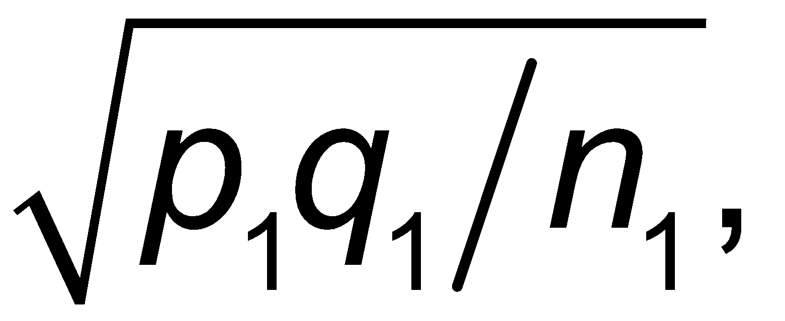
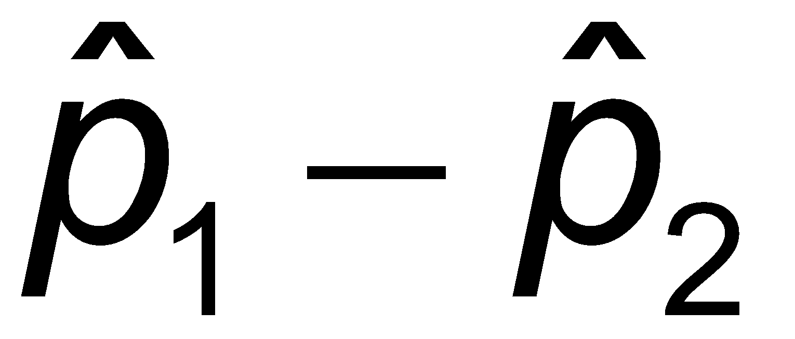
Why Do the Procedures of This Section Work?
The distribution of can be approximated by a normal distribution with mean p₁, standard deviation and variance p₁q₁/n₁.
The difference can be approximated by a normal distribution with mean p₁ – p₂ and variance
The variance of the differences between two independent random variables is the sum of their individual variances.
Copyright © 2010 Pearson Education

Slide 29
Why Do the Procedures of This Section Work?
The preceding variance leads to
We now know that the distribution of p₁ – p₂ is approximately normal, with mean p₁ – p₂ and standard deviation as shown above, so the z test statistic has the form given earlier.
Copyright © 2010 Pearson Education

Slide 30
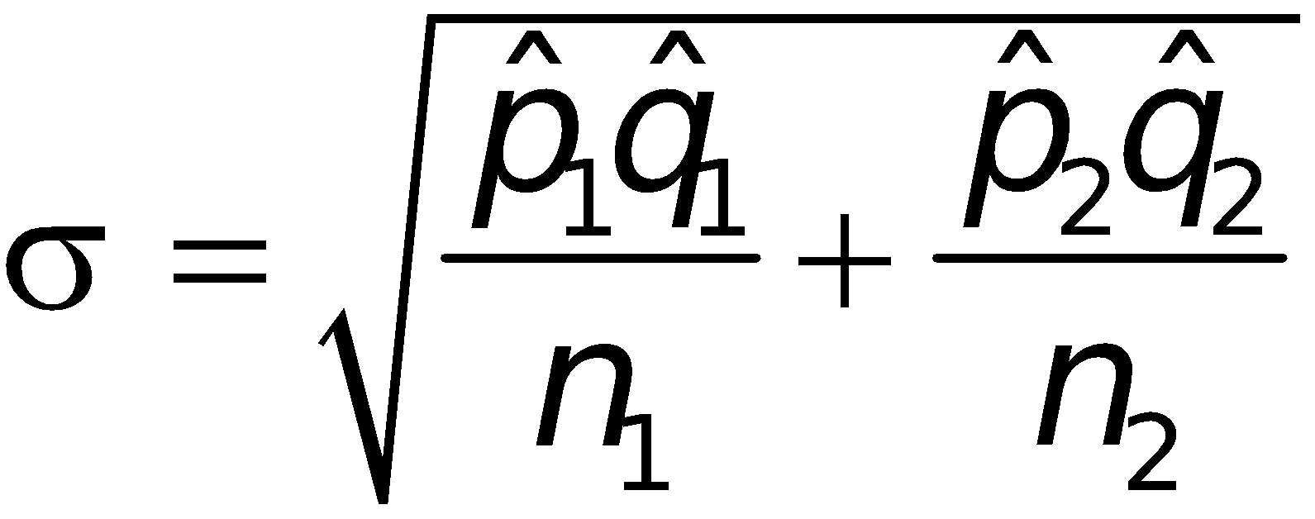
Why Do the Procedures of This Section Work?
When constructing the confidence interval estimate of the difference between two proportions, we don’t assume that the two proportions are equal, and we estimate the standard deviation as
Copyright © 2010 Pearson Education

Slide 31
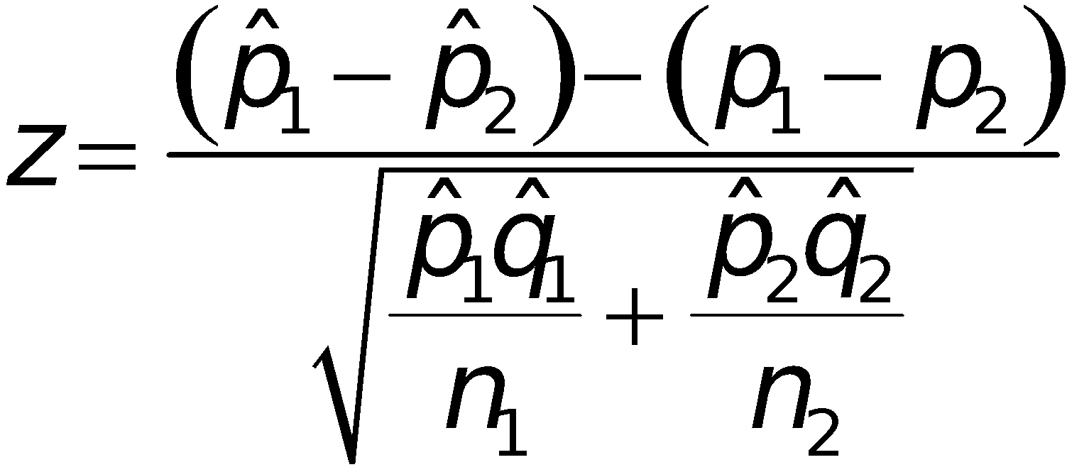
Why Do the Procedures of This Section Work?
In the test statistic
use the positive and negative values of z (for two tails) and solve for p₁ – p₂. The results are the limits of the confidence interval given earlier.
Copyright © 2010 Pearson Education

Slide 32
Recap
In this section we have discussed:
Requirements for inferences about two proportions.
Notation.
Pooled sample proportion.
Hypothesis tests.
Copyright © 2010 Pearson Education

Slide 33
Section 9-3
Inferences About Two Means: Independent Samples
Copyright © 2010 Pearson Education

Slide 34
Key Concept
This section presents methods for using sample data from two independent samples to test hypotheses made about two population means or to construct confidence interval estimates of the difference between two population means.
Copyright © 2010 Pearson Education

Slide 35
Key Concept
In Part 1 we discuss situations in which the standard deviations of the two populations are unknown and are not assumed to be equal. In Part 2 we discuss two other situations: (1) The two population standard deviations are both known; (2) the two population standard deviations are unknown but are assumed to be equal. Because is typically unknown in real situations, most attention should be given to the methods described in Part 1.
Copyright © 2010 Pearson Education

Slide 36
Part 1: Independent Samples with σ₁ and σ₂ Unknown and Not Assumed Equal
Copyright © 2010 Pearson Education

Slide 37
Definitions
Two samples are independent if the sample values selected from one population are not related to or somehow paired or matched with the sample values from the other population.
Two samples are dependent if the sample values are paired. (That is, each pair of sample values consists of two measurements from the same subject (such as before/after data), or each pair of sample values consists of matched pairs (such as husband/wife data), where the matching is based on some inherent relationship.)
Copyright © 2010 Pearson Education
Notes:
Text will use the wording ‘matched pairs’.
Example at bottom of page 469-470 of Elementary Statistics, 10th Edition

Slide 38
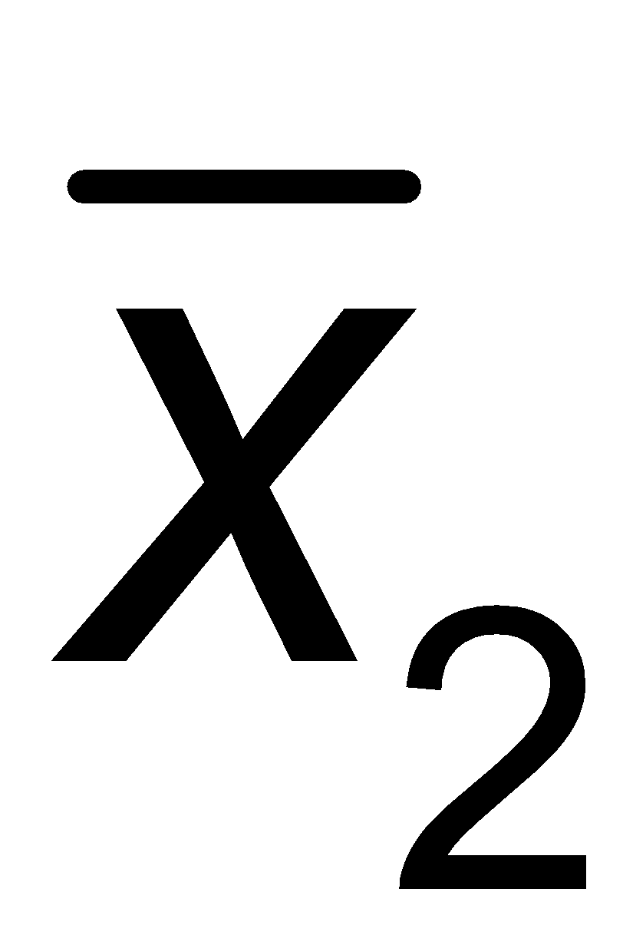
Notation
μ₁ = population mean
σ₁ = population standard deviation
n₁ = size of the first sample
= sample mean
s₁ = sample standard deviation
Corresponding notations for μ₂, σ₂, s₂, and n₂ apply to population 2.
Copyright © 2010 Pearson Education
Notes:
page 470 of Elementary Statistics, 10th Edition

Slide 39
Requirements
1. σ₁ an σ₂ are unknown and no assumption is made about the equality of σ₁ and σ₂ .
2. The two samples are independent.
3. Both samples are simple random samples.
4. Either or both of these conditions are satisfied: The two sample sizes are both large (with n₁ > 30 and n₂ > 30) or both samples come from populations having normal distributions.
Copyright © 2010 Pearson Education
Notes:
page 470 of Elementary Statistics, 10th Edition

Slide 40
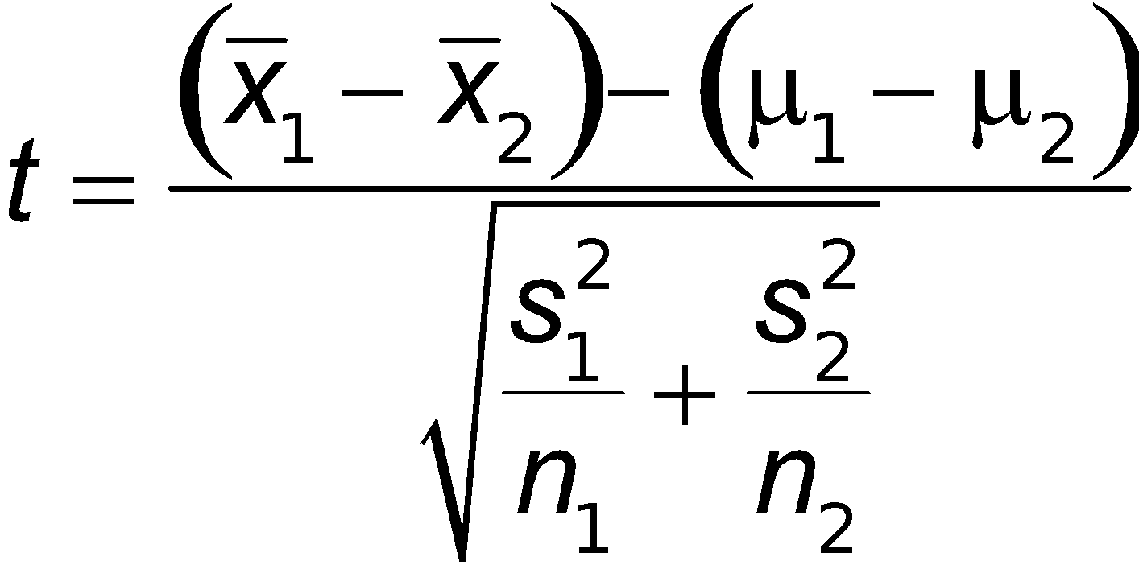
Hypothesis Test for Two Means: Independent Samples
(where μ₁ – μ₂ is often assumed to be 0)
Copyright © 2010 Pearson Education

Slide 41
Hypothesis Test - cont
Test Statistic for Two Means: Independent Samples
Degrees of freedom: In this book we use this simple and conservative estimate: df = smaller of n₁ – 1 and n₂ – 1.
P-values: Refer to Table A-3. Use the procedure summarized in Figure 8-5.
Critical values: Refer to Table A-3.
Copyright © 2010 Pearson Education

Slide 42
Confidence Interval Estimate of μ₁ – μ₂: Independent Samples
(x₁ – x₂) – E < (µ₁ – µ₂) < (x₁ – x₂) + E
s₁
s₂
where E = t_{α/2}
2
2
+
n₂
n₁
where df = smaller n₁ – 1 and n₂ – 1
Copyright © 2010 Pearson Education

Slide 43
Caution
Before conducting a hypothesis test, consider the context of the data, the source of the data, the sampling method, and explore the data with graphs and descriptive statistics. Be sure to verify that the requirements are satisfied.
Copyright © 2010 Pearson Education

Slide 44
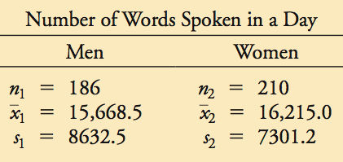
Example:
A headline in USA Today proclaimed that “Men, women are equal talkers.” That headline referred to a study of the numbers of words that samples of men and women spoke in a day. Given below are the results from the study. Use a 0.05 significance level to test the claim that men and women speak the same mean number of words in a day. Does there appear to be a difference?
Copyright © 2010 Pearson Education

Slide 45
Example:
Requirements are satisfied: two population standard deviations are not known and not assumed to be equal, independent samples, simple random samples, both samples are large.
Step 1: Express claim as μ₁ = μ₂.
Step 2: If original claim is false, then μ₁ ≠ μ₂.
Step 3: Alternative hypothesis does not contain equality, null hypothesis does.
H₀ : μ₁ = μ₂ (original claim) H_{a} : μ₁ ≠ μ₂
Proceed assuming μ₁ = μ₂ or μ₁ – μ₂ = 0.
Copyright © 2010 Pearson Education

Slide 46
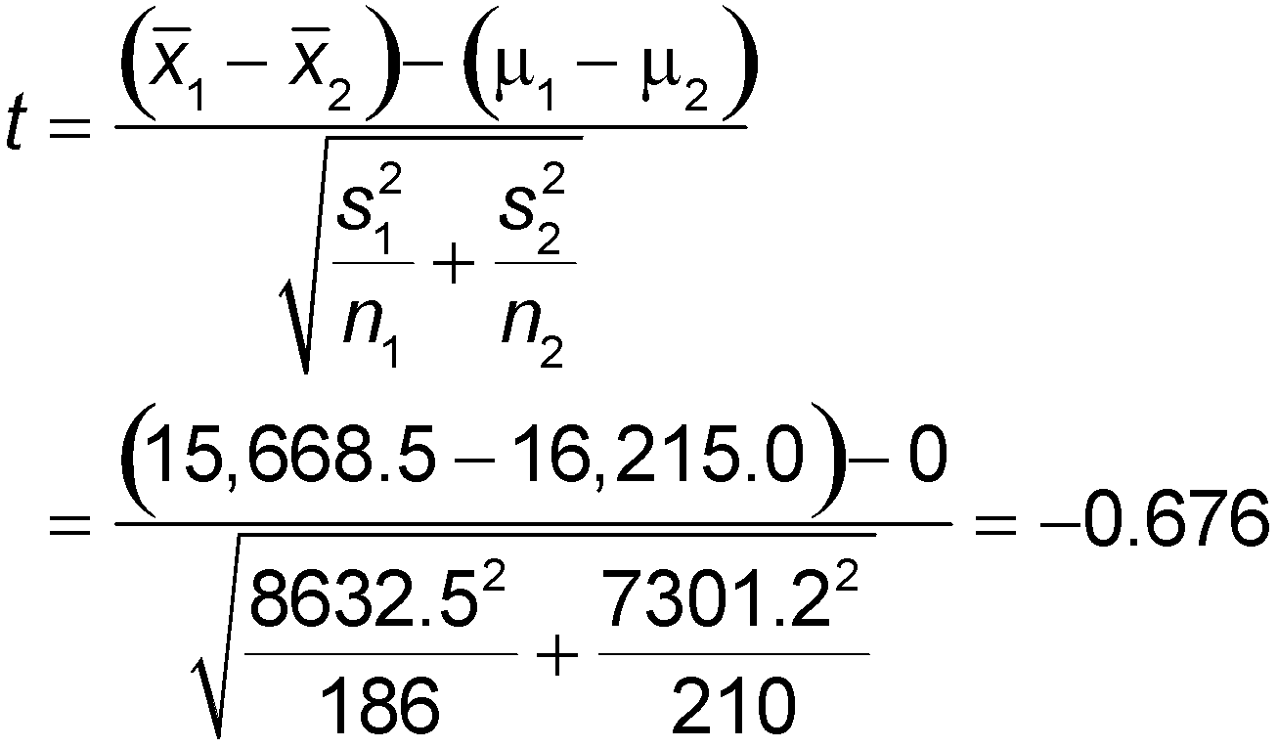
Example:
Step 4: Significance level is 0.05
Step 5: Use a t distribution
Step 6: Calculate the test statistic
Copyright © 2010 Pearson Education

Slide 47
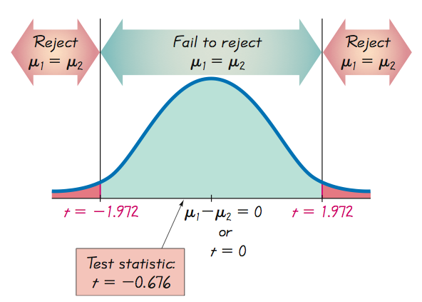
Example:
Use Table A-3: area in two tails is 0.05, df = 185, which is not in the table, the closest value is t = ±1.972
Copyright © 2010 Pearson Education

Slide 48
Example:
Step 7: Because the test statistic does not fall within the critical region, fail to reject the null hypothesis: μ₁ = μ₂ (or μ₁ – μ₂ = 0).
There is not sufficient evidence to warrant rejection of the claim that men and women speak the same mean number of words in a day. There does not appear to be a significant difference between the two means.
Copyright © 2010 Pearson Education

Slide 49
Example:
Using the sample data given in the previous Example, construct a 95% confidence interval estimate of the difference between the mean number of words spoken by men and the mean number of words spoken by women.
Copyright © 2010 Pearson Education

Slide 50
Example:
Requirements are satisfied as it is the same data as the previous example.
Find the margin of Error, E; use t_{α/2} = 1.972
Construct the confidence interval use E = 1595.4 and
Copyright © 2010 Pearson Education

Slide 51
Example:
Step 4: Significance level is 0.05
Step 5: Use a t distribution
Step 6: Calculate the test statistic
Copyright © 2010 Pearson Education

Slide 52
Example:
Use Table A-3: area in two tails is 0.05, df = 185, which is not in the table, the closest value is t = ±1.972
Copyright © 2010 Pearson Education

Slide 53
Example:
Step 7: Because the test statistic does not fall within the critical region, fail to reject the null hypothesis: μ₁ = μ₂ (or μ₁ – μ₂ = 0).
There is not sufficient evidence to warrant rejection of the claim that men and women speak the same mean number of words in a day. There does not appear to be a significant difference between the two means.
Copyright © 2010 Pearson Education

Slide 54
Part 2: Alternative Methods
Copyright © 2010 Pearson Education

Slide 55
Independent Samples with σ₁ and σ₂ Known.
Copyright © 2010 Pearson Education

Slide 56
Requirements
1. The two population standard deviations are both known.
2. The two samples are independent.
3. Both samples are simple random samples.
4. Either or both of these conditions are satisfied: The two sample sizes are both large (with n₁ > 30 and n₂ > 30) or both samples come from populations having normal distributions.
Copyright © 2010 Pearson Education

Slide 57
Hypothesis Test for Two Means: Independent Samples with σ₁ and σ₂ Both Known
z =
(x₁ – x₂) – (µ₁ – µ₂)
σ₁
σ₂
2
2
+
n₂
n₁
P-values and critical values: Refer to Table A-2.
Copyright © 2010 Pearson Education

Slide 58
Confidence Interval: Independent Samples with σ₁ and σ₂ Both Known
(x₁ – x₂) – E < (µ₁ – µ₂) < (x₁ – x₂) + E
σ₁
σ₂
where E = z_{α/2}
2
2
+
n₂
n₁
Copyright © 2010 Pearson Education

Slide 59
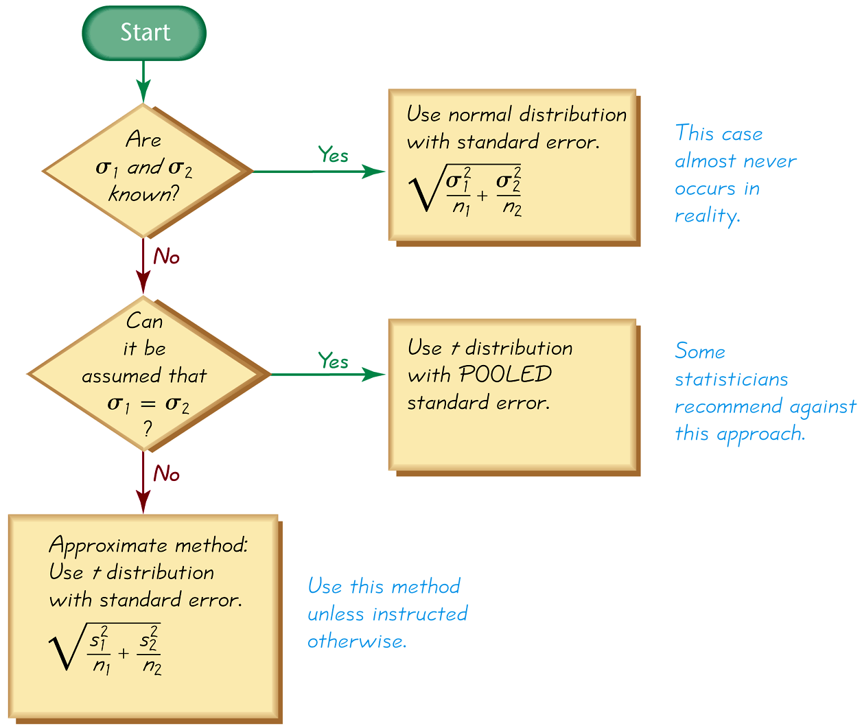
Methods for Inferences About Two Independent Means
Figure 9-3
Copyright © 2010 Pearson Education

Slide 60
Assume that σ₁ = σ₂ and Pool the Sample Variances.
Copyright © 2010 Pearson Education

Slide 61
Requirements
1. The two population standard deviations are not known, but they are assumed to be equal. That is σ₁ = σ₂.
2. The two samples are independent.
3. Both samples are simple random samples.
4. Either or both of these conditions are satisfied: The two sample sizes are both large (with n₁ > 30 and n₂ > 30) or both samples come from populations having normal distributions.
Copyright © 2010 Pearson Education

Slide 62
Hypothesis Test Statistic for Two Means: Independent Samples and σ₁ = σ₂
t =
(x₁ – x₂) – (µ₁ – µ₂)
s_{p}
s_{p}
2
2
+
n₂
n₁
Where
s_{p}.
s₁
s₂
2
2
2
= (n₁ – 1) + (n₂ -1)
(n₁ – 1) + (n₂ – 1)
and the number of degrees of freedom is df = n₁ + n₂ - 2
Copyright © 2010 Pearson Education

Slide 63
Confidence Interval Estimate of μ₁ – μ₂: Independent Samples with σ₁ = σ₂
(x₁ – x₂) – E < (µ₁ – µ₂) < (x₁ – x₂) + E
s_{p}
s_{p}
where E = t_{α/2}
2
2
+
n₂
n₁
and number of degrees of freedom is df = n₁ + n₂ - 2
Copyright © 2010 Pearson Education

Slide 64
Strategy
Unless instructed otherwise, use the following strategy:
Assume that σ₁ and σ₂ are unknown, do not assume that σ₁ = σ₂, and use the test statistic and confidence interval given in Part 1 of this section. (See Figure 9-3.)
Copyright © 2010 Pearson Education

Slide 65
Recap
In this section we have discussed:
Independent samples with the standard deviations unknown and not assumed equal.
Alternative method where standard deviations are known
Alternative method where standard deviations are assumed equal and sample variances are pooled.
Copyright © 2010 Pearson Education

Slide 66
Section 9-4
Inferences from Matched Pairs
Copyright © 2010 Pearson Education

Slide 67
Key Concept
In this section we develop methods for testing hypotheses and constructing confidence intervals involving the mean of the differences of the values from two dependent populations.
With dependent samples, there is some relationship whereby each value in one sample is paired with a corresponding value in the other sample.
Copyright © 2010 Pearson Education

Slide 68
Key Concept
Because the hypothesis test and confidence interval use the same distribution and standard error, they are equivalent in the sense that they result in the same conclusions. Consequently, the null hypothesis that the mean difference equals 0 can be tested by determining whether the confidence interval includes 0. There are no exact procedures for dealing with dependent samples, but the t distribution serves as a reasonably good approximation, so the following methods are commonly used.
Copyright © 2010 Pearson Education

Slide 69
Notation for Dependent Samples
d = individual difference between the two values of a single matched pair
µ_{d} = mean value of the differences d for the population of paired data
d = mean value of the differences d for the paired sample data (equal to the mean of the x – y values)
s_{d} = standard deviation of the differences d for the paired sample data
n = number of pairs of data.
Copyright © 2010 Pearson Education

Slide 70
Requirements
1. The sample data are dependent.
2. The samples are simple random samples.
3. Either or both of these conditions is satisfied: The number of pairs of sample data is large (n > 30) or the pairs of values have differences that are from a population having a distribution that is approximately normal.
Copyright © 2010 Pearson Education
Notes:
page 485 of Elementary Statistics, 10th Edition

Slide 71
Hypothesis Test Statistic for Matched Pairs
d – µ_{d}
t =
s_{d}
n
where degrees of freedom = n – 1
Copyright © 2010 Pearson Education
Notes:
page 485 of Elementary Statistics, 10th Edition

Slide 72
P-values and
Critical Values
Use Table A-3 (t-distribution).
Copyright © 2010 Pearson Education
Notes:
page 485 of Elementary Statistics, 10th Edition
Hypothesis example given on this page

Slide 73
Confidence Intervals for Matched Pairs
d – E < µ_{d} < d + E
where E = t_{α/2}
s_{d}
n
Critical values of t_{α/2} : Use Table A-3 with n – 1 degrees of freedom.
Copyright © 2010 Pearson Education

Slide 74
Example:
Data Set 3 in Appendix B includes measured weights of college students in September and April of their freshman year. Table 9-1 lists a small portion of those sample values. (Here we use only a small portion of the available data so that we can better illustrate the method of hypothesis testing.) Use the sample data in Table 9-1 with a 0.05 significance level to test the claim that for the population of students, the mean change in weight from September to April is equal to 0 kg.
Copyright © 2010 Pearson Education

Slide 75
Example:
Requirements are satisfied: samples are dependent, values paired from each student; although a volunteer study, we’ll proceed as if simple random sample and deal with this in the interpretation; STATDISK displays a histogram that is approximately normal
Copyright © 2010 Pearson Education

Slide 76
Example:
Weight gained = April weight – Sept. weight
μ_{d} denotes the mean of the “April – Sept.” differences in weight; the claim is μ_{d} = 0 kg
Step 1: claim is μ_{d} = 0 kg
Step 2: If original claim is not true, we have μ_{d} ≠ 0 kg
Step 3: H₀: μ_{d} = 0 kg original claim H₁: μ_{d} ≠ 0 kg
Step 4: significance level is α = 0.05
Step 5: use the student t distribution
Copyright © 2010 Pearson Education

Slide 77
Example:
Step 6: find values of d and s_{d} differences are: –1, –1, 4, –2, 1 d = 0.2 and s_{d} = 2.4 now find the test statistic
Table A-3: df = n – 1, area in two tails is 0.05, yields a critical value t = ±2.776
Copyright © 2010 Pearson Education

Slide 78
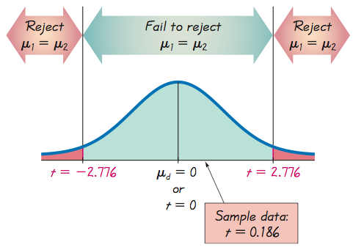
Example:
Step 7: Because the test statistic does not fall in the critical region, we fail to reject the null hypothesis.
Copyright © 2010 Pearson Education

Slide 79
Example:
We conclude that there is not sufficient evidence to warrant rejection of the claim that for the population of students, the mean change in weight from September to April is equal to 0 kg. Based on the sample results listed in Table 9-1, there does not appear to be a significant weight gain from September to April.
Copyright © 2010 Pearson Education

Slide 80
Example:
The conclusion should be qualified with the limitations noted in the article about the study. The requirement of a simple random sample is not satisfied, because only Rutgers students were used. Also, the study subjects are volunteers, so there is a potential for a self-selection bias. In the article describing the study, the authors cited these limitations and stated that “Researchers should conduct additional studies to better characterize dietary or activity patterns that predict weight gain among young adults who enter college or enter the workforce during this critical period in their lives.”
Copyright © 2010 Pearson Education

Slide 81
Example:
The P-value method:
Using technology, we can find the P-value of 0.8605. (Using Table A-3 with the test statistic of t = 0.186 and 4 degrees of freedom, we can determine that the P-value is greater than 0.20.) We again fail to reject the null hypothesis, because the P-value is greater than the significance level of α = 0.05.
Copyright © 2010 Pearson Education

Slide 82
Example:
Confidence Interval method:
Construct a 95% confidence interval estimate of μ_{d} , which is the mean of the “April–September” weight differences of college students in their freshman year.
= 0.2, s_{d} = 2.4, n = 5, t_{a/2} = 2.776
Find the margin of error, E
Copyright © 2010 Pearson Education

Slide 83
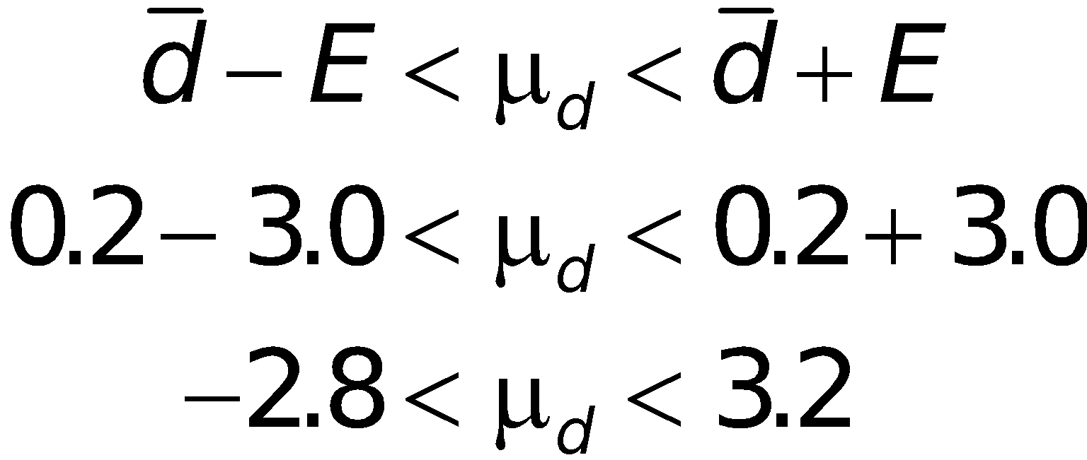
Example:
Construct the confidence interval:
We have 95% confidence that the limits of 2.8 kg and 3.2 kg contain the true value of the mean weight change from September to April. In the long run, 95% of such samples will lead to confidence interval limits that actually do contain the true population mean of the differences.
Copyright © 2010 Pearson Education

Slide 84
Recap
In this section we have discussed:
Requirements for inferences from matched pairs.
Notation.
Hypothesis test.
Confidence intervals.
Copyright © 2010 Pearson Education

Slide 85
Section 9-5
Comparing Variation in Two Samples
Copyright © 2010 Pearson Education

Slide 86
Key Concept
This section presents the F test for comparing two population variances (or standard deviations). We introduce the F distribution that is used for the F test.
Note that the F test is very sensitive to departures from normal distributions.
Copyright © 2010 Pearson Education

Slide 87
Part 1
F test for Comparing Variances
Copyright © 2010 Pearson Education

Slide 88
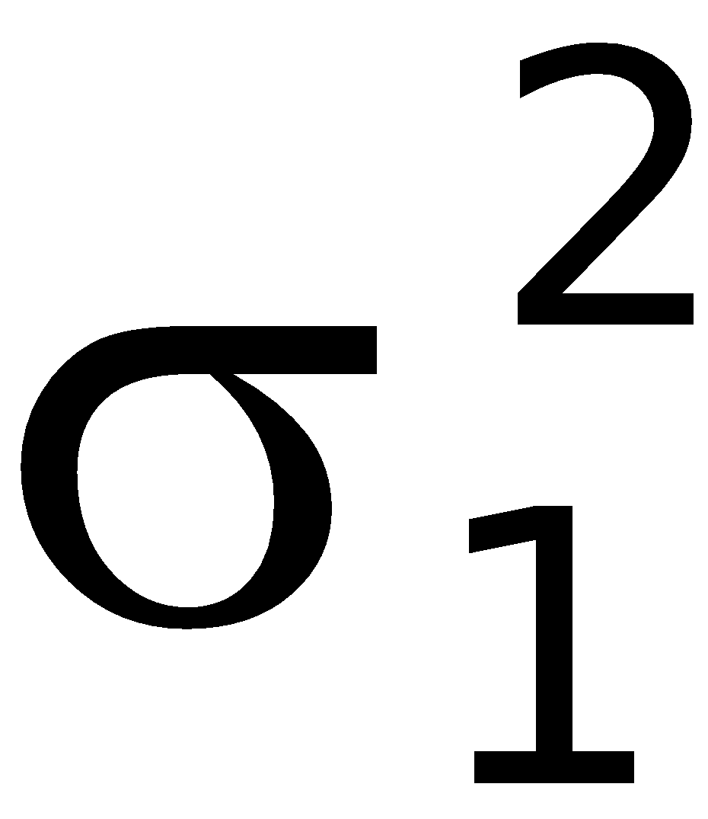
Notation for Hypothesis Tests with Two Variances or Standard Deviations
= larger of two sample variances
= size of the sample with the larger variance
= variance of the population from which the sample with the larger variance is drawn
are used for the other sample and population
Copyright © 2010 Pearson Education
Notes:
page 495 of Elementary Statistics, 10th Edition

Slide 89
Requirements
1. The two populations are independent.
2. The two samples are simple random samples.
3. The two populations are each normally distributed.
Copyright © 2010 Pearson Education
Notes:
Students may need a reminder of the definition of independent from Section 9-2.
The normal distribution requirement is quite strict with the methods discussed in this section.
Use of the normal quantile plots (section 6-7) will be important to determine normality

Slide 90
Test Statistic for Hypothesis Tests with Two Variances
s₁
2
Where s₁² is the larger of the two sample variances
F
=
s₂
2
Critical Values: Using Table A-5, we obtain critical F values that are determined by the following three values:
1. The significance level α
2. Numerator degrees of freedom = n₁ – 1
3. Denominator degrees of freedom = n₂ – 1
Copyright © 2010 Pearson Education

Slide 91
The F distribution is not symmetric.
Properties of the F Distribution
Values of the F distribution cannot be negative.
The exact shape of the F distribution depends on the two different degrees of freedom.
Copyright © 2010 Pearson Education
Notes:
page 496 of Elementary Statistics, 10th Edition

Slide 92
Finding Critical F Values
To find a critical F value corresponding to a 0.05 significance level, refer to Table A-5 and use the right-tail are of 0.025 or 0.05, depending on the type of test:
Two-tailed test: use 0.025 in right tail
One-tailed test: use 0.05 in right tail
Copyright © 2010 Pearson Education
Notes:
page 496 of Elementary Statistics, 10th Edition

Slide 93
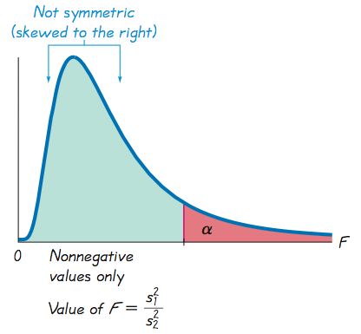
Finding Critical F Values
Copyright © 2010 Pearson Education
Notes:
page 496 of Elementary Statistics, 10th Edition

Slide 94
Properties of the F Distribution - continued
If the two populations do have equal variances, then F = will be close to 1 because and are close in value.
s₁
2
s₂
2
s₁
s
2
2
2
Copyright © 2010 Pearson Education
Notes:
page 497 of Elementary Statistics, 10th Edition
Give some numerical examples of the computation of F close to 1.

Slide 95
Properties of the F Distribution - continued
If the two populations have radically different variances, then F will be a large number.
Remember, the larger sample variance will be s₁ .
2
Copyright © 2010 Pearson Education
Notes:
Give some numerical examples of an F value that is not close to 1.

Slide 96
Conclusions from the F Distribution
Consequently, a value of F near 1 will be evidence in favor of the conclusion that σ₁ = σ₂ .
2
2
But a large value of F will be evidence against the conclusion of equality of the population variances.
Copyright © 2010 Pearson Education

Slide 97
Example:
Data Set 20 in Appendix B includes weights (in g) of quarters made before 1964 and weights of quarters made after 1964. Sample statistics are listed below. When designing coin vending machines, we must consider the standard deviations of pre-1964 quarters and post-1964 quarters. Use a 0.05 significance level to test the claim that the weights of pre-1964 quarters and the weights of post-1964 quarters are from populations with the same standard deviation.
Copyright © 2010 Pearson Education

Slide 98
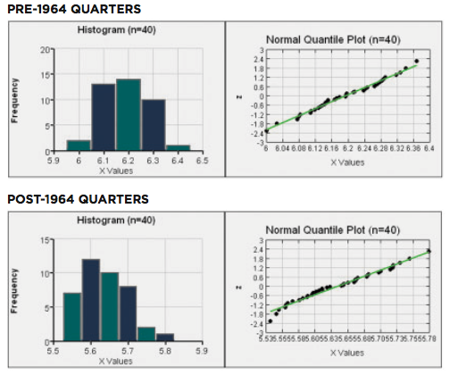
Example:
Requirements are satisfied: populations are independent; simple random samples; from populations with normal distributions
Copyright © 2010 Pearson Education

Slide 99
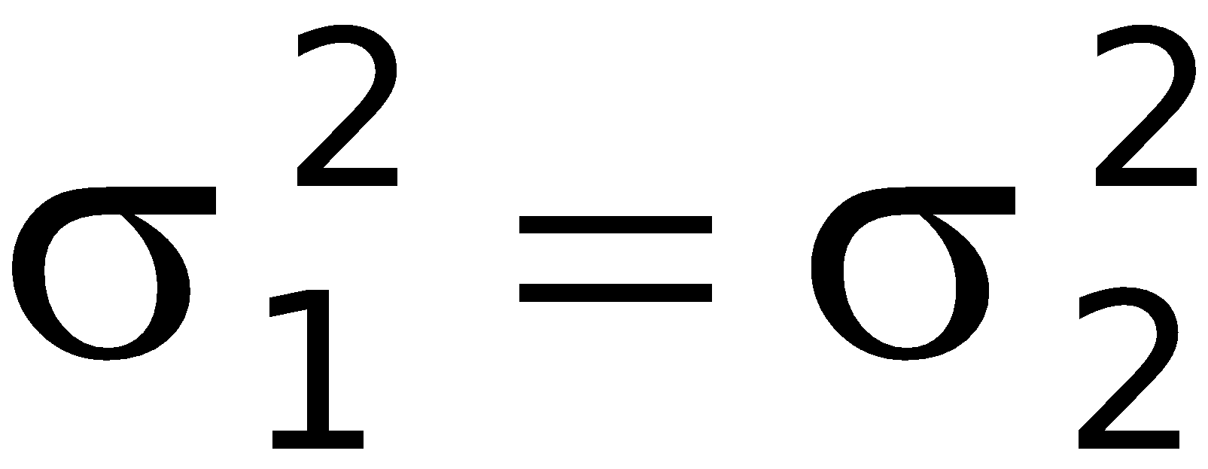
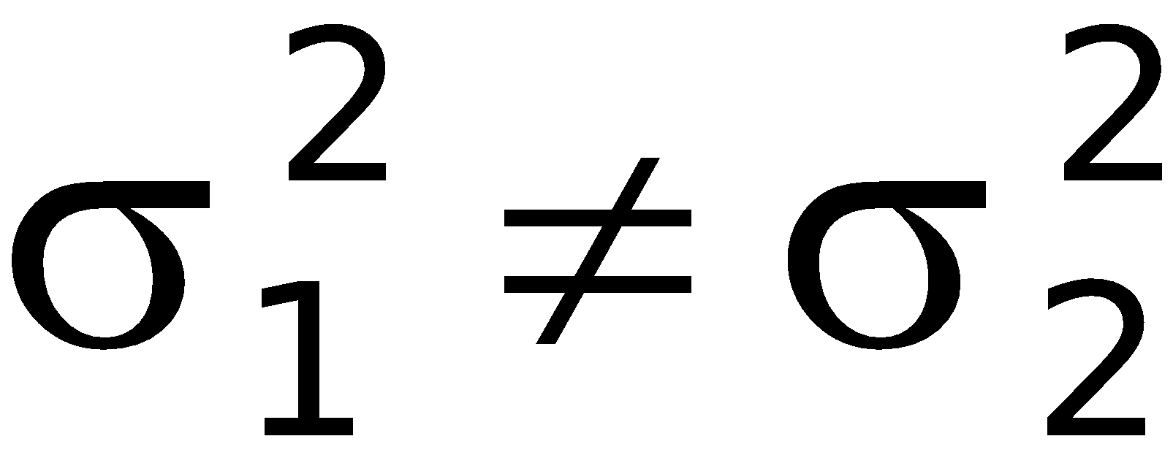
Example:
Use sample variances to test claim of equal population variances, still state conclusion in terms of standard deviations.
Step 1: claim of equal standard deviations is equivalent to claim of equal variances
Step 2: if the original claim is false, then
Step 3:
original claim
Copyright © 2010 Pearson Education

Slide 100
Example:
Step 4: significance level is 0.05
Step 5: involves two population variances, use F distribution variances
Step 6: calculate the test statistic
For the critical values in this two-tailed test, refer to Table A-5 for the area of 0.025 in the right tail. Because we stipulate that the larger variance is placed in the numerator of the F test statistic, we need to find only the right-tailed critical value.
Copyright © 2010 Pearson Education

Slide 101
Example:
From Table A-5 we see that the critical value of F is between 1.8752 and 2.0739, but it is much closer to 1.8752. Interpolation provides a critical value of 1.8951, but STATDISK, Excel, and Minitab provide the accurate critical value of 1.8907.
Step 7: The test statistic F = 1.9729 does fall within the critical region, so we reject the null hypothesis of equal variances. There is sufficient evidence to warrant rejection of the claim of equal standard deviations.
Copyright © 2010 Pearson Education

Slide 102
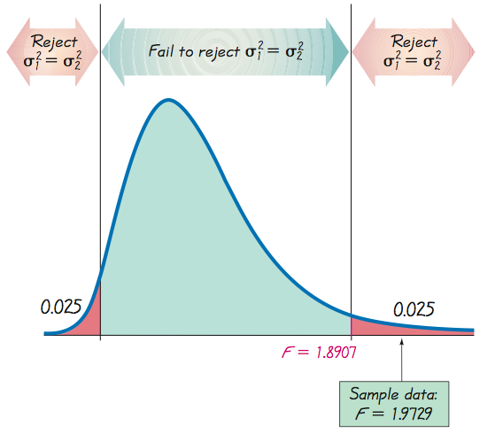
Example:
Copyright © 2010 Pearson Education

Slide 103
Example:
There is sufficient evidence to warrant rejection of the claim that the two standard deviations are equal. The variation among weights of quarters made after 1964 is significantly different from the variation among weights of quarters made before 1964.
Copyright © 2010 Pearson Education

Slide 104
Recap
In this section we have discussed:
Requirements for comparing variation in two samples
Notation.
Hypothesis test.
Confidence intervals.
F test and distribution.
Copyright © 2010 Pearson Education

